Slide 1
NextHikes IT Solutions Project 2: Data Harmonization and Insights Extraction
Title: Exploratory Data Analysis and Insights from dataset_1, dataset_2 and dataset_3
Subtitle: A Comprehensive Data Wrangling and Insights Extraction Project
Your Name: Manoj kapri
Date: 02.01.2025

Slide 2
Objective
To explore and analyze the dataset’s for actionable insights.
To clean and preprocess the data for effective analysis.
To uncover trends and patterns to inform business decisions.
Scope
Analyzed customer transactions, demographics, and product preferences.

Slide 3
Data Wrangling Steps
Load Datasets
1
Load Dataset_1, Dataset_2, and Dataset_3 for analysis.
2
Inspect Data Quality
3
Use .info() and .head() to check the structure and identify any issues.
4
Handle Missing Values
5
Fill missing data using appropriate methods to maintain data accuracy.
6
Merge Datasets
7
Combine datasets using common keys and create a single dataset for analysis.
8

Slide 4
Actions:
Loaded dataset and performed initial inspection (.head(),.info())
Checked for null values, duplicate records, and inconsistent data types.
Key Outcome:
Identified missing data, inconsistent formats, and outliers.

Slide 5
Handling Missing Data
Methods Used:
For Numerical Data: Imputed missing values with median.
For Categorical Data: Imputed missing values with the mode.
Dropped Rows/Columns: Removed columns with excessive missing data.
Visualization: Missing Data Heatmap

Slide 6
Outlier Detection & Treatment
Methods Used:
Boxplots and Z-scores to identify extreme outliers.
Outlier Treatment: Removed or capped values based on IQR (Interquartile Range) method.
Visualization: Boxplot for Outlier Detection

Slide 7
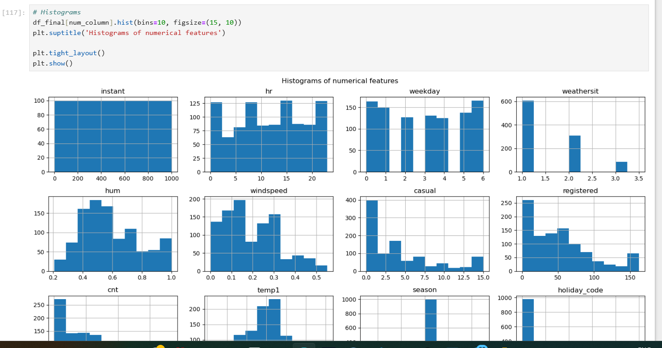
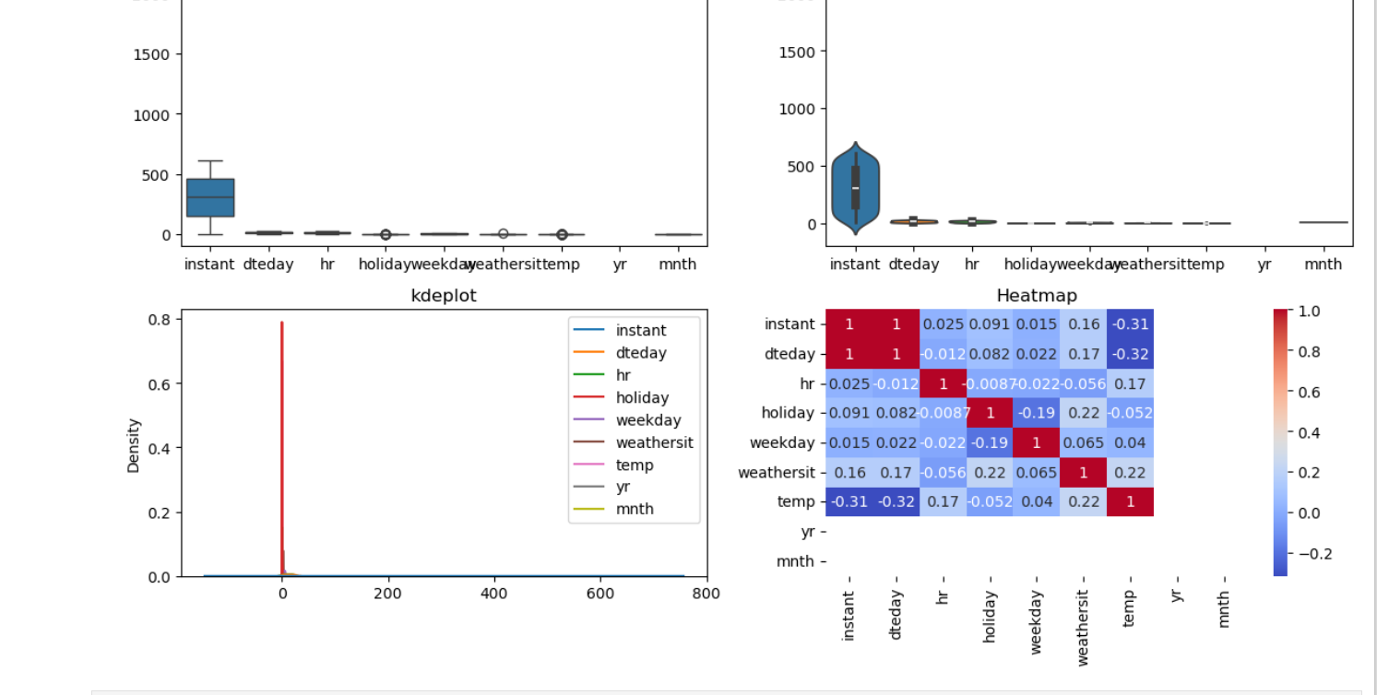

Slide 8
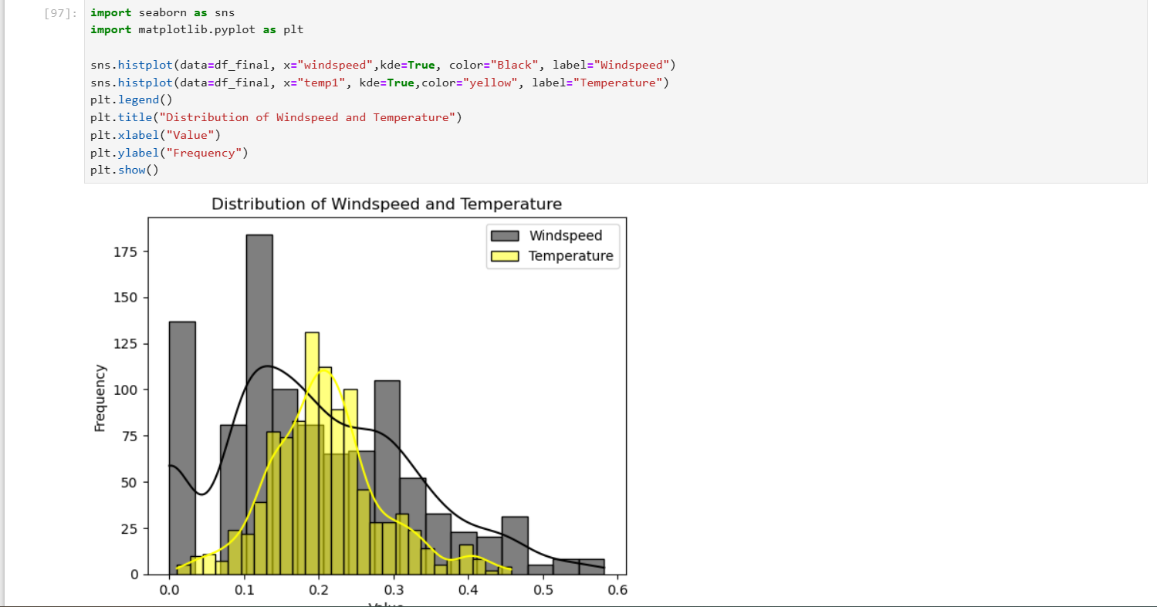
HISTPLOT

Slide 9

Data Type Conversion
Actions Taken:
Converted Age to age groups for easier analysis.
Changed Date columns to datetime format.
Applied one-hot encoding to categorical variables (e.g., gender, product categories).
Outcome: Prepared data for analysis and machine learning models.

Slide 10
Key Challenge
Key Challenge 2 - Outliers
Key Challenge 1 - Missing Data
Challenge: Missing values in key columns (e.g., product ratings, transaction dates).
Solution: Imputation and removal of rows with missing values exceeding a threshold.
Outcome: The data became more consistent and ready for analysis.
Challenge: Outliers skewed the distribution of key metrics..
Solution: Used IQR to identify and treat extreme values.
Outcome: Cleaned data enabled more accurate analysis and modeling.

Slide 11
Key Challenge
Key Challenge 3 - Missing Data
Key Challenge 3 - Irregular Time Intervals
Challenge: Time-series data with irregular gaps in dates.
Solution: Resampling the data with consistent time intervals (monthly or weekly) and filling gaps using forward/backward filling.
Outcome: Ensured reliable time-series analysis.

Slide 12
Key Insights and Takeaways:
Unified Dataset Construction | Successfully combined multiple datasets into a comprehensive and clean dataset for in-depth analysis.
Sophisticated Data-Wrangling Methods | Employed advanced techniques to address data inconsistencies and ambiguities efficiently.
In-Depth Exploratory Data Analysis | Conducted data exploration to uncover key trends and relationships within the datasets.
Effective Visualization of Findings | Leveraged diverse visualization tools like heatmaps and scatter plots to present insights clearly and impactfully.
Enhanced Practical Skills | Strengthened expertise in data preparation, wrangling, and cleaning for advanced modeling and business use cases.

Slide 13
Conclusion
Key Takeaways:
Importing the data and Pre processing the data
Data cleaning and wrangling were critical to extracting meaningful insights.
Customer segmentation and sales trends revealed opportunities for targeted strategies.
Actionable insights: Focus on high-value customers, optimize product inventory, and plan marketing around seasonal trends.

Slide 14
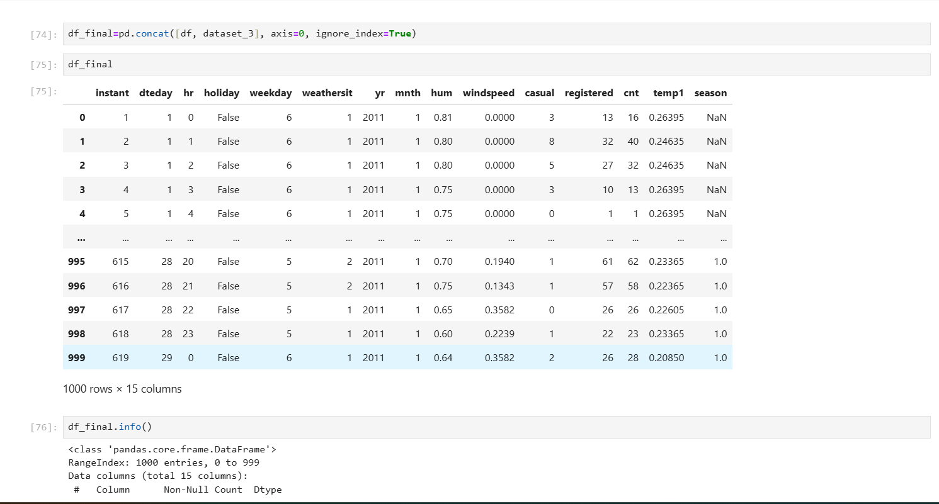

Slide 15
THANK YOU

